Slide 1
Bluetooth

Slide 2
Bluetooth
A wireless standard (like WiFi) designed for point-to-point communication
Primary applications
Connect peripheral devices (mouse, keyboard, headphones, fitness trackers)
Radio Frequency Identification (RFID)
Maximum range of ~100m
Two types (same range:
Bluetooth Classic
Designed for higher-throughput connections such as audio
Persistent wireless connection (radio stays on)
Bluetooth Low Energy (BLE) (what we’ll use)
Designed for low-throughput, low-power connections
Radios connect at negotiated intervals for short bursts

Slide 3
Advertising
Bluetooth device broadcasts its address and some advertising payload data (configurable) at a regular rate (e.g. every 1s)
Very low power usage (uA)
Key component to RFID
Received Strength of Signal Indicator (RSSI) - dBm
AirTag, Tile primarily work this way (also now ultra wide band)

Slide 4
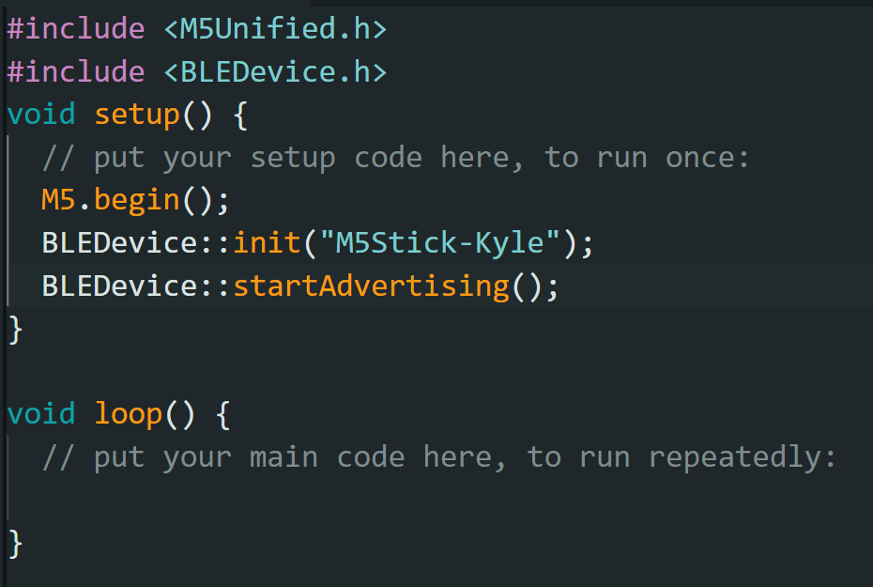
Advertising on the M5StickCPlus (ESP32)

Slide 5
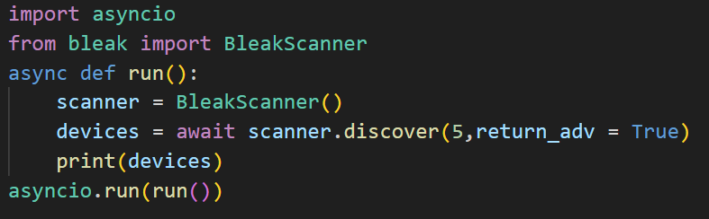
Bluetooth in Python via Bleak
Bleak is a modern, cross-platform python library for BLE
Uses “asynchronous” programming features of python, which allow events to be “awaited” within async functions
Requires an “event loop” to run (asyncio.run) … more on this later
pip install bleak

Slide 6
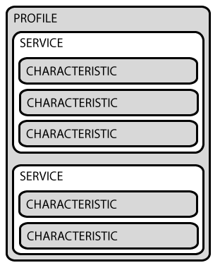
Doing More with GATT Profiles
If we connect to a device, we can send/receive data
Generic ATTribute Profile
Consists of services, which consist of characteristics
Services attempt to standardize how to communicate with a device class
Characteristics are ultimately what is used to transmit and receive data
See https://learn.adafruit.com/introduction-to-bluetooth-low-energy/gatt?view=all for a more in-depth explanation

Slide 7
Characteristics
UUID - Universally Unique ID (https://www.uuidgenerator.net/)
Properties
Read - Value can be read by a client on demand (polling, e.g., what is the temperature?)
Write - Value can be written by a client on demand (e.g., set the motor to this speed)
Notify/Indicate - Updated values are automatically sent to the client (e.g., this is the new value of the accelerometer)
Only when enabled by the client
Value
Usually, <= 20 bytes of data
Newer version of Bluetooth (4.2+) allow for more by changing the Maximum Transmission Unit
Descriptors
Hold useful information about the characteristic (e.g., name), and may be read/written depending on the type
Notify/Indicate require a special writable descriptor (0x2902) called the CCCD (client characteristic configuration descriptor)

Slide 8
Connection Intervals and Data Rates
BLE normally uses a data rate of 1Mbps at the “link” layer (operates on 2.4Ghz spectrum)
In practice, less, because of protocol overhead.
Client and Server only connect to each other so often to exchange data
Minimum and maximum values, between 7.5ms and 4s
Negotiated by client and server
Higher is better to reduce power consumption
Several packets may be sent each connection
Varies by device, interference

Slide 9
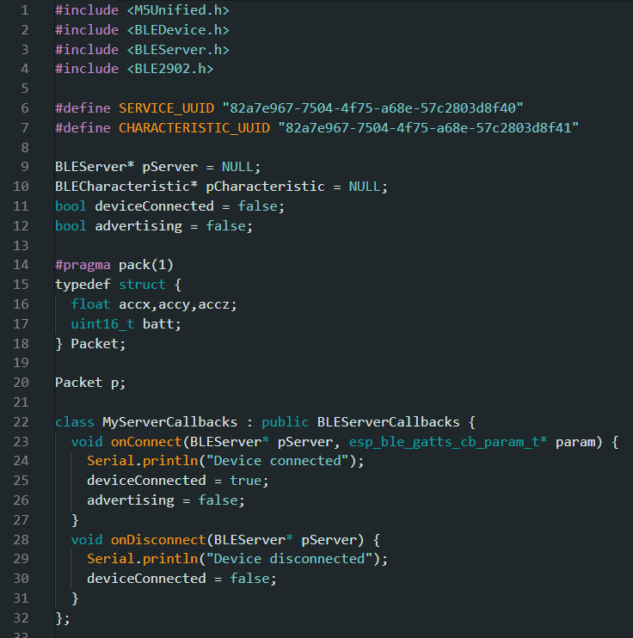
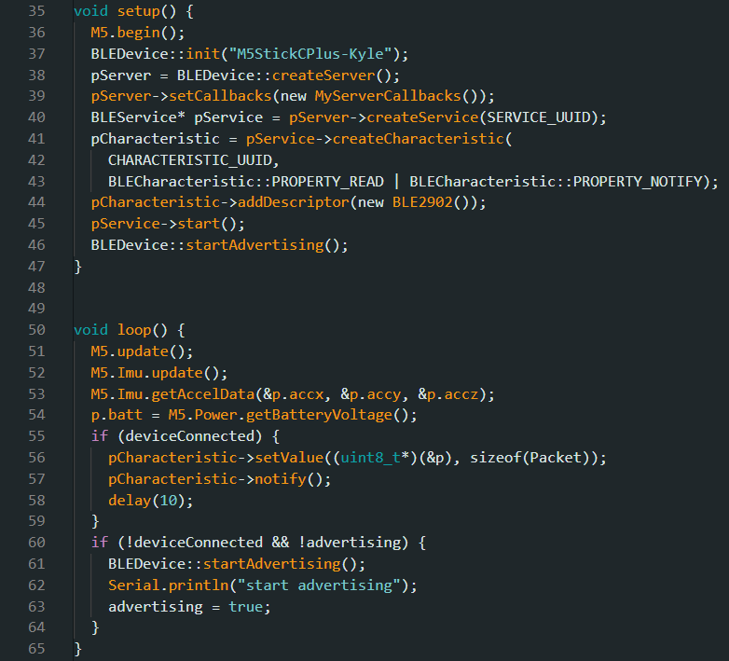
Minimal Bluetooth M5Stick (1 characteristic)

Slide 10
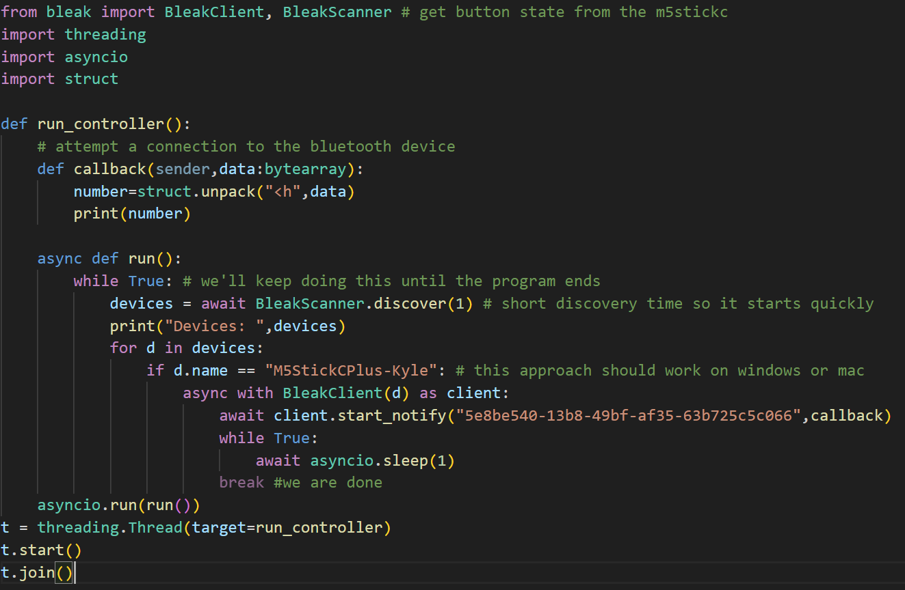
Note the use of threads, which allows you to mix in other event loops

Slide 11
Bluetooth or WiFi?
WiFi is generally better, if it’s available
Much more bandwidth available
Multiple devices can communicate with each other
But you may already be using your WiFi radio to connect to the internet
Also, the other device might not have WiFi
Bluetooth is normally used for devices that can be used anywhere, in an ad hoc manner
M5StickCPlus is not the most power-efficient Bluetooth sensor (better as the “central”)

